Slide 1

PARI - SHE IS SECURE
By Kalyani samanta
Akriti Singh
Debadutta panda

Slide 2

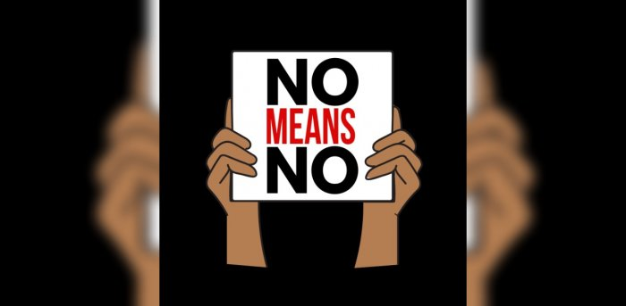
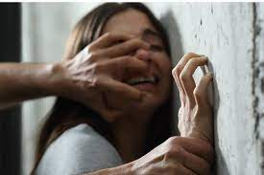
How we came on this idea?
Our team has always been inquisitive about security purpose projects.so we have decided to do a security based project which we think will be more beneficial especially to the women of our society.
furthermore ,now a days smartphones are so very common in today’s modern generation.So we thought of making an app based on Android which will make the efficient use of mobile phones and serve the rising crimes against women.
This is how we planned to do something unique yet productive for social cause.

Slide 3
Introduction
Women safety is a very important issue as the crime against women are rising exponentially these days.most of the women of various ages,till this day are being subjected to violence,domestic abuse, and rape.
As ladies ought to travel late night generally,it is necessary to remain alert and safe.Although govt. Is taking necessary measures for their safety,still there are free safety apps for women that can help them to stay safe.
This is user friendly application that can be accessed by anyone who has installed it in their smartphones. Our intention is to provide you with fastest and nearest help possible.The user needs to store multiple emergency contacts in this app ,in case of emergency it can send messages to all the emergency contact list just with a single touch. The other person can also trace the victim’s location as well as her current location by the use of GPS and latitudinal or longitudinal view respectively.Don’t you think it’s interesting??This features for both everyday safety and real emergencies,making it an ultimate tool for all.

Slide 4
INTRODUCTION
=System Design

Slide 5
How the System is designed
Client-server Architecture
Database Architecture
3-tier Architecture
ER diagram
Data Flow Diagram
Contributed by Akriti singh & Kalyani samanta

Slide 6
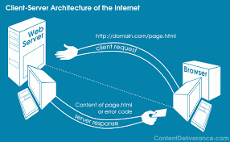
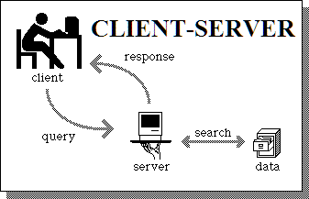
Client-Server Architecture
Our system is simply based on client server architecture where the client send the message to server and server replies back to client.
This is basically the request-response messaging pattern.client provide an interface to allow a computer user to requests services of the server and to display the results server returns.
When all requests are met,the sequence is complete and the web browser presents it to the user.
Notes:
Add some more point

Slide 7
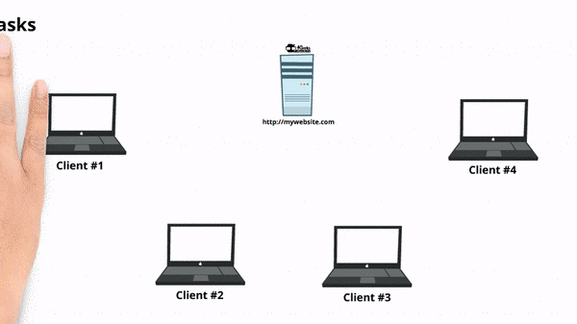
Communication Between Client-server
Clients and servers exchange messages in a request–response messaging pattern. The client sends a request, and the server returns a response. This exchange of messages is an example of inter-process communication. To communicate, the computers must have a common language, and they must follow rules so that both the client and the server know what to expect. The language and rules of communication are defined in a communications protocol. All protocols operate in the application layer.A server may receive requests from many distinct clients in a short period of time. A computer can only perform a limited number of tasks at any moment, and relies on a scheduling system to prioritize incoming requests from clients to accommodate them. To prevent abuse and maximize availability, the server software may limit the availability to clients.

Slide 8
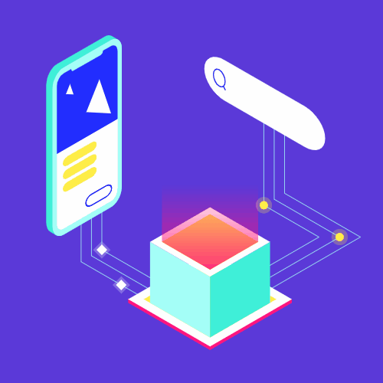
DataBase Architecture
Database architecture focuses on the design, development, implementation and maintenance of computer programs that store and organize information for businesses, agencies and institutions. A database architect develops and implements software to meet the needs of users. The design of a DBMS depends on its architecture.
Notes:
Debadutta can better write it because he himself has implemented.if you cant do then plz explain this part to me ,i will write in my own language

Slide 9
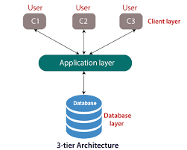
3-tier Architecture
Three-tier architecture is a well-established software application architecture that organizes applications into three logical and physical computing tiers: the presentation tier, or user interface; the application tier, where data is processed; and the data tier, where the data associated with the application is stored and managed.
The chief benefit of three-tier architecture is that because each tier runs on its own infrastructure, each tier can be developed simultaneously by a separate development team, and can be updated or scaled as needed without impacting the other tiers.
For decades three-tier architecture was the prevailing architecture for client-server applications.

Slide 10
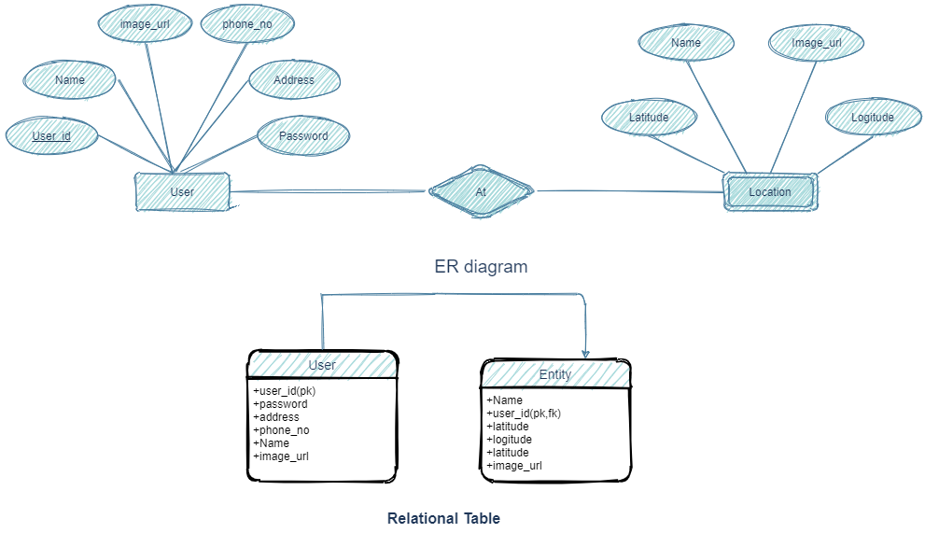
ER Diagram
Weak Entity Set:
In this scenario, an user can have one location and one location can depend on one user. A location does not have any existence without an employee (e.g; you as a child can be dependant of your father in his company). So it will be a weak entity and its participation will always be total. Weak Entity does not have key of its own.So its key will be combination of key of its identifying entity (userId of user in this case).
Notes:
Figure is not clearly visible so i am unable to write this part.
Reference link :-https://www.geeksforgeeks.org/mapping-from-er-model-to-relational-model/
Write something about weak entity set(refer this page not exactly same but relate with our project)

Slide 11
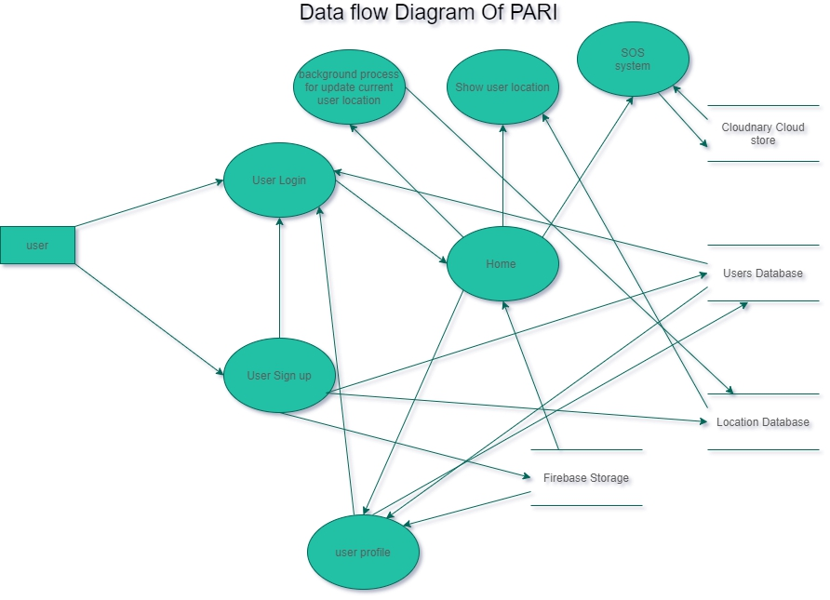
Data Flow Diagram

Slide 12
Implementation

Slide 13
How is it Implemented
Android UI/UX
Application Features
Node js server
Connecting the Application with Nodejs
The SOS feature
Explaining the Implementation in brief(at end)
Future Work
Pros and cons of this application
conclusion
Contributed by Debadutta panda

Slide 14
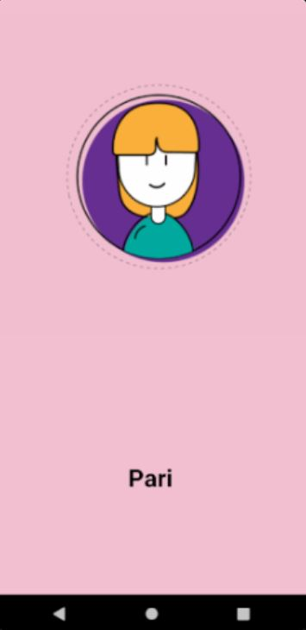
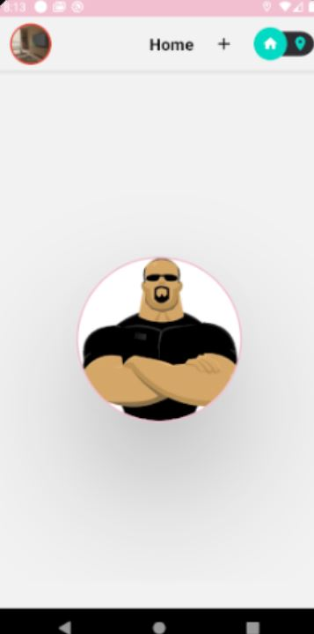
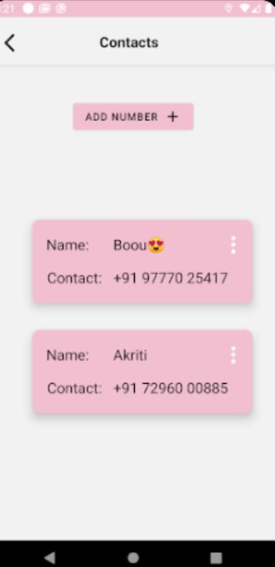
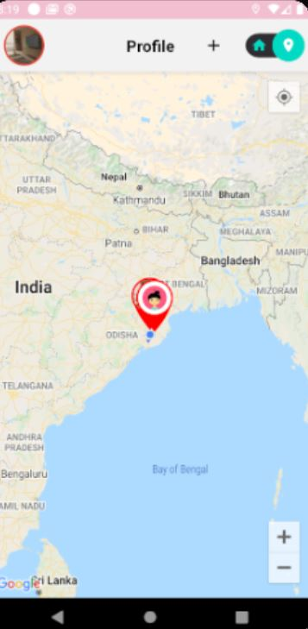
Android UI/UX
In today’s world of application development, the use of an interactive and productive User Experience (UX) and User Interface (UI) design is essential for creating stunning mobile app designs. The importance of UI/UX in mobile app development cannot be overemphasized as these features are coherently employed by most mobile app designers to create interactive mobile apps.
These days, most mobile app users prefer using apps that offer easy and quick navigation. Just so you know, app developers India seeking to attract willing end-users must consider designing their mobile applications with standard UI/UX features or risk having their apps fail woefully on the app store.

Slide 15

What are its unique features
Uses latitudinal and longitudinal view using back and front camera of the Android device to inspect the current situation of the victim.
Realtime updates
Works on all mobile networks.
Works on virtually all smartphones with GPS in them,which almost all smartphones already do.
Multiple contacts can be added in the emergency contact list.
This application also records the location of the victim.

Slide 16
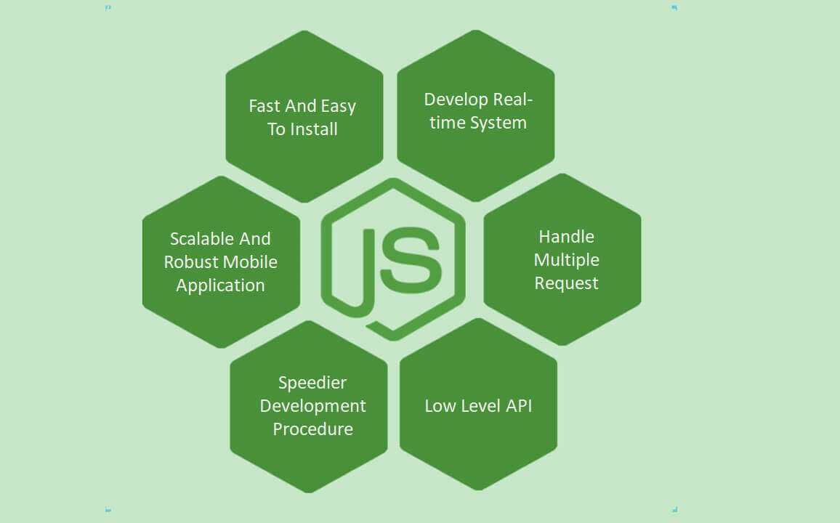
What exactly Node.js server is?
Node. js is a platform built on Chrome's JavaScript runtime for easily building fast and scalable network applications. Node. js uses an event-driven, non-blocking I/O model that makes it lightweight and efficient, perfect for data-intensive real-time applications that run across distributed devices.

Slide 17
Connecting the application with Node,js server
To connect The Android Application with Nodejs server we are going to use a package Known as Retrofit which is build on Java.net API.
This package helps to establish communication between server and our Server.It involve various API such as POST,GET.where POST request is a fundamental method, and this method is mostly used when a user wants to send some sensitive data to the server like to send a form or some confidential data And Get Request is used to retrieve and request data from a specified resource in a server. GET is one of the most popular HTTP request techniques. In simple words, the GET method is used to retrieve whatever information is identified by the Request-URL.

Slide 18
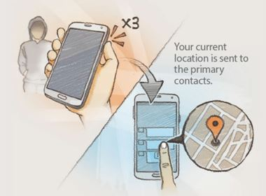
The SOS feature
You can send SOS Message to your Primary Contacts by pressing quickly the power key three times.SOS stands for "Save your souls". It lets your primary contacts know where you are, your current location, voice recordings and pictures.
Notes:
Akriti ???
Dekh rahiho kyaa Slide 7 sae suru karo

Slide 19
Project at a short glimpse

Slide 20
Future work
The project can be expanded further and be updated with more efficient features in near future.As time is changing the classification of crime over a specific gender is narrowing down and this app has the potential to be expanded fotr those times as well.This project has plenty of potential because computer technology continues to develop new methods and technology.
Yes of course at this point of time some more features can be added to make it more user friendly,those are:
unsafe zone can be pinned
Contact calling may be included.
Data checker may be implemented to avoid unauthorized data.

Slide 21
Pros and cons
PROS
CONS
It incorporates all the essential features such as GPS tracking, emergency contact numbers, directions to safe locations etc.
Smart24x7 app is available FREE
This application sends the live location of the user
User can store multiple contact numbers for the emergency situation.
Current situation of the victim can also be traced.
This app requires active Internet connection.
In the existing apps there is no monitoring system for girls.
There is no facility of pinning the Unsafe zones
User should give her correct details otherwise it behaves abnormally.

Slide 22
Conclusion

Slide 23
Conclusion
Nevertheless, this particular application is just one way offered by technology to minimize the chances of our being a victim of some violent crime or unexpected emergency.
Being totally oriented to Indian scenario, these apps bring resources to our fingertips so that we are capable of taking some immediate actions.
We just can’t sit back at home with the fear of any unwanted situation, so these apps are an effort to provide an assurance that we are not alone. So just be alert, be safe!
At last we want to end this by the quote”Your smart phone can be your safety boon if you can use it wisely”.

Slide 24


Thank you sir for your Support

